Slide 1
CS 5683: Cloud Computing and Distributed Systems Hadoop & MapReduce
Arunkumar Bagavathi
Department of Computer Science
Oklahoma State university

Slide 2
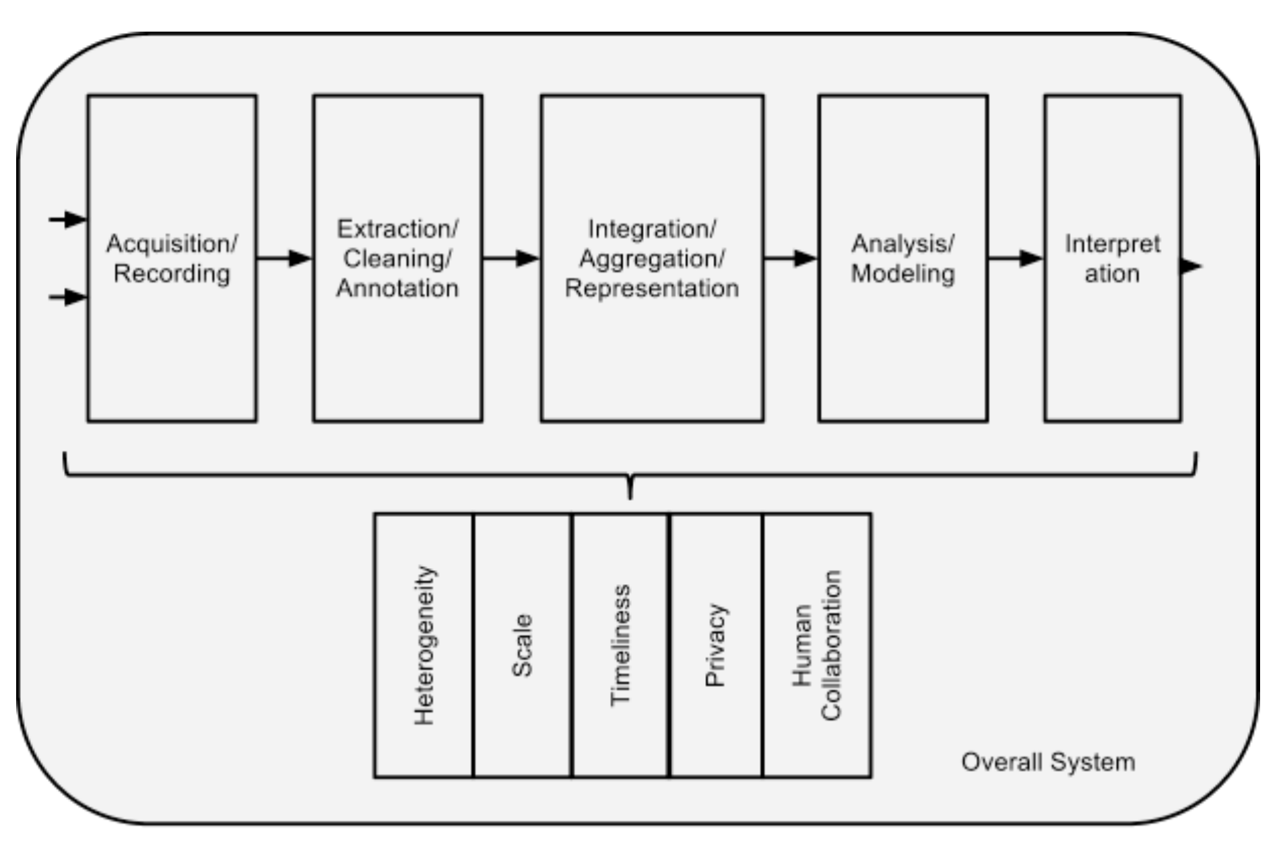
Big Data Challenges
Source: Labrinidis, Jagadish, ‘Challenges and opportunities with Big Data’, 2012

Slide 3



Traditional Solution
Enterprises adopt servers and databases to store and process big data
Enterprises use vendors such as Oracle and IBM to setup databases
Users interact with intermediate application, which in turn handles data querying, analysis and interpretation
Limitation: Volume of data

Slide 4
Motivation
Google web processing
Google holds 10-15 Exabytes of data to store web details
1 Exabyte = 10⁶ Terabyte
Requires 15 X 10⁶ hard drives to store the data
If the average speed of read is 500 MB/s, Google should take days to query and process results
Yet Google achieves processing is fraction of seconds. HOW?
With Cloud and Distributed Computing – Distribute the workload

Slide 5
Large Scale Computation
Massive data analysis can be efficiently done with distributed computing
Challenges:
How to distribute the workload?
Distributed/Parallel computing is not easy. WHY?
Failures – servers and computation
Data loss
Security
How to write distributed programs?

Slide 6
Distributed Computing Terminologies
Node – is an individual computer (physical/virtual)
Cluster – is a collection of nodes which work together in data storage, processing, and resource management
Master (Primary) node – manages distribution of data and processes
Worker (Secondary) node – stores data and work on tasks assigned by master

Slide 7

Basic Cluster Setup
Secondary nodes
Mostly LINUX machines
Connected with Ethernet
Primary node
Primary node

Slide 8
Computation Issue and Solution
Issue: How to distribute (big) data through the cluster network?
Solution: Distribute the computation instead
MapReduce:
Google’s algorithm to handle challenges in distributed computing
Easy parallel computing – and suitable for massive data sets
Elegant storage: GFS/HDFS
MapReduce features:
Automatic parallelization and distribution
Fault-tolerance
I/O scheduling
Status and monitoring
Google MapReduce Paper: Dean, Jeffrey, and Sanjay Ghemawat. "MapReduce: Simplified data processing on large clusters." (2004).
Link: https://research.google/pubs/pub62/

Slide 9

Hadoop is a software library which anyone can use for big data applications
Allows distributed processing of larger data sets in a clustered environment
Released by Apache in 2005
Key features:
Scale from single computer setup to cluster setup
Ability to detect and handle failures without programmer interception
Cost effective and easy to use
Source: http://hadoop.apache.org/

Slide 10







Hadoop Ecosystem
Notes:
Ambari – A web based tool for provisioning, managing, and monitoring Apache Hadoop clusters
Hbase - A scalable, distributed database that supports structured data storage for large tables
Hive - A data warehouse infrastructure that provides data summarization and ad hoc querying
Mahout - A Scalable machine learning and data mining library
Pig - A high-level data-flow language and execution framework for parallel computation
Spark - A fast and general compute engine for Hadoop data. Spark provides a simple and expressive programming model that supports a wide range of applications, including ETL, machine learning, stream processing, and graph computation
Zookeeper - A high-performance coordination service for distributed applications

Slide 11


Hadoop Modules
Hadoop Common – contains utilities to support other modules
Hadoop Distributed File System (HDFS)
YARN – manage resources and schedule jobs across clusters
MapReduce – parallel data processing
Hadoop Cluster
Processing
MapReduce
Spark
Storage
HDFS
Resource Management
YARN

Slide 12
Hadoop Versions
V1 – Adoption of Google’s MapReduce
V2 – Introduction of YARN
Hadoop V1.0
Hadoop V2.0
Hadoop Ecosystem
Hadoop Ecosystem
MapReduce
MapReduce
YARN
HDFS
HDFS
Hadoop Commons
Hadoop Commons

Slide 13
HDFS
File system based on Google File System
HDFS replicates data when storing to tackle node failures
HDFS applications has to be Write-Once and Read-Many type
Appending the data is possible
Inserting data at an arbitrary position is not possible
Move computation near the data
Take the algorithms/programs to the node where data resides or to the nearby node

Slide 14
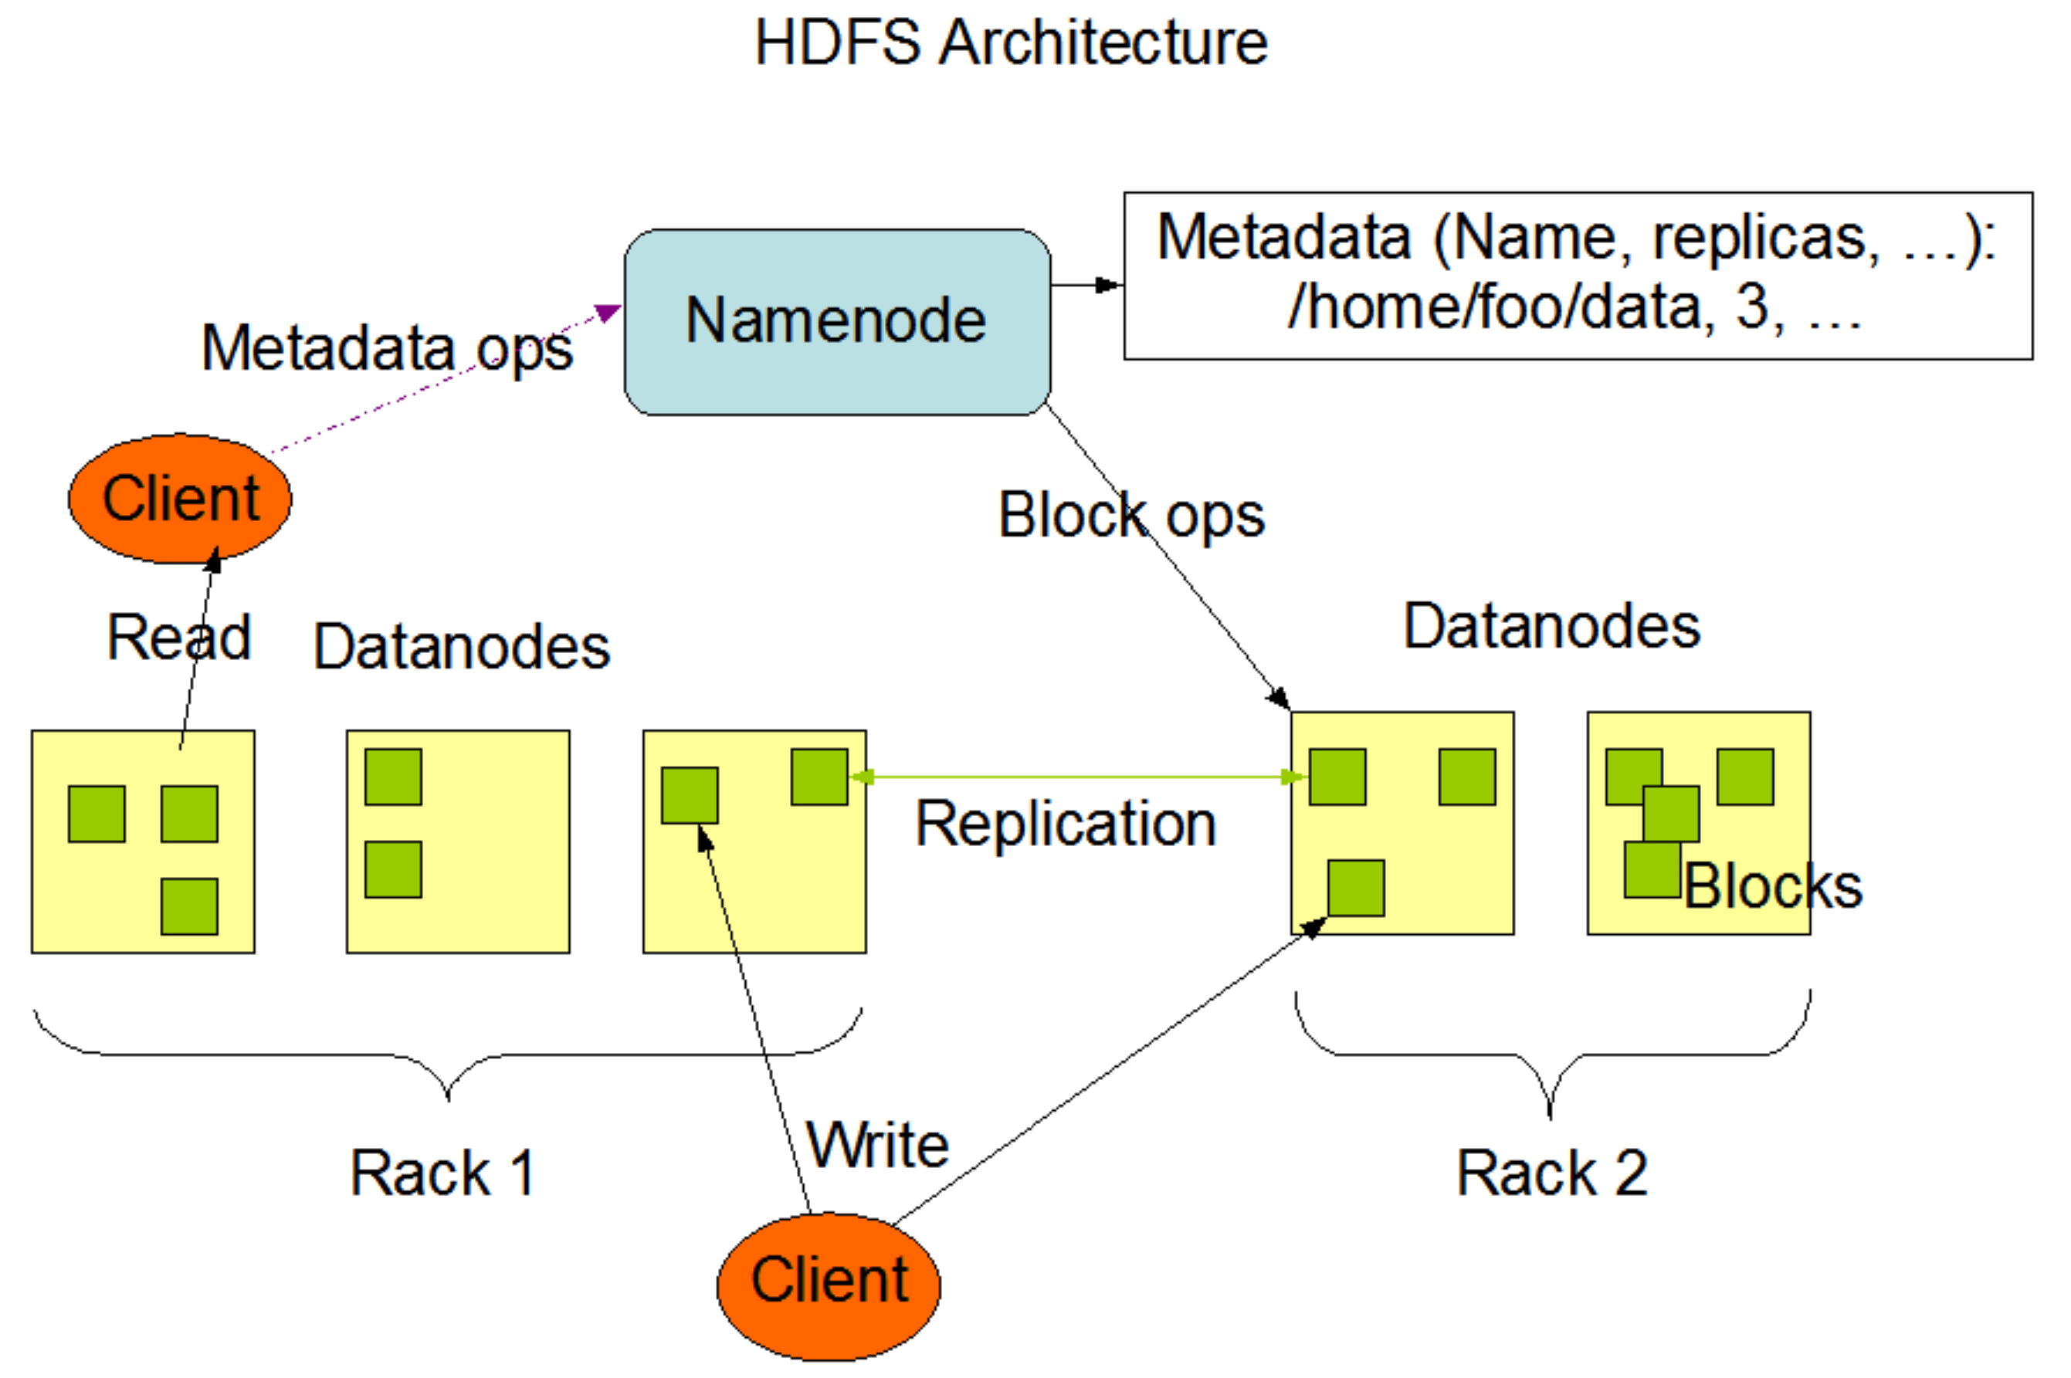
HDFS Architecture
Primary components in HDFS:
Name node – manages file system namespace (opening, closing, and renaming files and directories), and manages mapping of blocks to data nodes
Data node – stores data blocks/partitions, serves for read/write requests, and perform operations (block creation, deletion, and replication)
Source: Hadoop.apache.org

Slide 15

HDFS Data Storage (1)
Large files are split into partitions (each block with maximum of 128MB)
Each block is replicated (3x time by default). Replication factor can be changed during the runtime.
Namenode stores information about data partitions
Node A
Node B
Metadata
Doc. 1
1.1, 1.2, and 1.3
Doc. 1: B1.1, B1.2, B1.3
Doc. 2: B2.1, B2.2
Node C
Node D
B1.1: A, C, D
B1.2: B, C, F
B1.3: D, E, F
B2.1: A, B, E
B2.2: C, D, F
Doc. 2
2.1, and 2.2
Node E
Node F
HDFS Cluster
Namenode

Slide 16
HDFS Data Storage (2)
Node A
Node B
1.1
2.1
1.2
2.1
Doc. 1
Metadata
1.1
1.2
1.3
Doc. 1: B1.1, B1.2, B1.3
Doc. 2: B2.1, B2.2
Node C
Node D
1.1
1.2
1.1
1.3
B1.1: A, C, D
B1.2: B, C, F
B1.3: D, E, F
B2.1: A, B, E
B2.2: C, D, F
Doc. 2
2.2
2.2
2.1
2.2
Node E
Node F
1.3
2.1
1.2
1.3
Namenode
2.2
HDFS Cluster

Slide 17

HDFS Data Retrieval (1)
Metadata
Doc. 1: B1.1, B1.2, B1.3
Doc. 2: B2.1, B2.2
Node A
Node B
1.1
2.1
1.2
2.1
1.1
B1.1: A, C, D
B1.2: B, C, F
B1.3: D, E, F
B2.1: A, B, E
B2.2: C, D, F
Doc. 1
1.2
1.3
Node C
Node D
1.1
1.2
1.1
1.3
Namenode
Doc. 2
2.1
2.2
2.2
B2.1, B2.2
2.2
Where is Doc. 2?
Node E
Node F
1.3
2.1
1.2
1.3
2.2
HDFS Cluster
Client

Slide 18
HDFS Data Retrieval (2)
Metadata
Doc. 1: B1.1, B1.2, B1.3
Doc. 2: B2.1, B2.2
Node A
Node B
1.1
2.1
1.2
2.1
1.1
B1.1: A, C, D
B1.2: B, C, F
B1.3: D, E, F
B2.1: A, B, E
B2.2: C, D, F
Doc. 1
1.2
1.3
Node C
Node D
1.1
1.2
1.1
1.3
Namenode
Doc. 2
2.1
2.2
2.2
B2.1, B2.2
2.2
Where is Doc. 2?
Node E
Node F
1.3
2.1
1.2
1.3
2.2
HDFS Cluster
Client

Slide 19
HDFS Namenode Availability
Failure in the Namenode cause inaccessibility of data nodes for all applications
HDFS is designed to be available all the time
Thus there are two Namenodes:
Active Namenode
Stand-by Namenode – Maintains checkpoint information of the Namenode and provides fast failover
More at: https://hadoop.apache.org/docs/current/hadoop-project-dist/hadoop-hdfs/HDFSHighAvailabilityWithNFS.html

Slide 20
YARN
Yet Another Resource Negotiator
Hadoop’s cluster resource management system
Provide facilities to work with cluster resources like storage and memory
Although introduced to improve MapReduce implementation, it also support Spark, Hive, Pig, etc
Users do not write programs for YARN processing – we do not need to worry about taking computation to respected nodes

Slide 21
MapReduce Programming Model
MapReduce programming modules
map
combine (Optional)
reduce
I/O of all functions: key-value pairs
map(in_key, in_value) -> list(out_key, intermediate_value)
In some cases output of the map() is the final output. Mostly not!
Intermediate results are written to disk instead of passing to reduce tasks
reduce(out_key, list(intermediate_value)) -> list(final_key/final_value)
Combines intermediate values of every key
Applies a function on the combined values and produces output

Slide 22
MapReduce : Example Task
TASK
Perform wordcount
Store sorted results
The Girl with the Dragon Tattoo
The Girl on the Train
Gone Girl

Slide 23
MapReduce : Basic Operation
DISK
The Girl with the Dragon Tattoo
The Girl on the Train
Gone Girl
Partition, Shuffle & Sort
MAP
REDUCE
DISK (part-r-00000)
dragon 1
girl 3
gone 1
tattoo 1
the 4
train 1
on 1
with 1

Slide 24
MapReduce : Basic Operation
DISK
MAP
The Girl with the Dragon Tattoo
The Girl on the Train
Gone Girl
REDUCE
MAP
REDUCE
MAP
DISK (part-r-00000)
dragon 1
girl 3
gone 1
tattoo 1
the 4
train 1
on 1
with 1

Slide 25
MapReduce : Basic Map Operation
map(in_key, in_value) -> list(out_key, intermediate_value)
DISK write
<?,The Girl with the Dragon Tattoo>
dragon 1
girl 1
tattoo 1
the 1
the 1
with 1
MAP
DISK
The Girl with the Dragon Tattoo
The Girl on the Train
Gone Girl
<?,The Girl on the Train>
MAP
girl 1
the 1
the 1
train 1
on 1
<?, Gone Girl>
Remember from HDFS!
Hadoop splits input file into blocks
1 map() for each data block
MAP
girl 1
gone 1
Notes:
Hadoop saves blocks into nodes
Map input keys are byte offset and considered irrelevant

Slide 26
MapReduce : Basic Reduce Operation
reduce(out_key, list(intermediate_value)) -> list(final_key/final_value)
Consider 2 reduce() are running for this example
DISK (part-r-00000)
DISK
dragon 1
gone 1
tattoo 1
train 1
on 1
with 1
dragon 1
girl 1
tattoo 1
the 1
the 1
with 1
<dragon, [1]>
<gone, [1]>
<tattoo, [1]>
<train, [1]>
<on, [1]>
<with, [1]>
REDUCE
girl 1
the 1
the 1
train 1
on 1
<girl, [1,1,1]>
<the, [1,1,1,1]>
DISK (part-r-00001)
REDUCE
girl 3
the 4
girl 1
gone 1
Notes:
Notice content change in the green box!
Sorted
Values became list
Partitioned

Slide 27
MapReduce : What happens after Map()
map(in_key, in_value) -> list(out_key, intermediate_value)
Partition
Sort
Combine (optional)
DISK write
<?,The Girl with the Dragon Tattoo>
dragon 1
girl 1
tattoo 1
the 1
the 1
with 1
MAP
DISK
The Girl with the Dragon Tattoo
The Girl on the Train
Gone Girl
<?,The Girl on the Train>
MAP
girl 1
the 1
the 1
train 1
on 1
<?, Gone Girl>
Remember from HDFS!
Hadoop splits input file into blocks
1 map() for each data block
MAP
girl 1
gone 1
Notes:
Partition with HashPartitioner

Slide 28
MapReduce : What happens after Map()
map(in_key, in_value) -> list(out_key, intermediate_value)
Partition – special cases for more than 1 reduce()
Sort
Partition phase
Sort phase
DISK write
the 1
girl 1
the 1
dragon 1
tattoo 1
with 1
dragon 1
girl 1
tattoo 1
the 1
the 1
with 1
dragon 1
girl 1
tattoo 1
the 1
the 1
with 1
the 1
girl 1
the 1
on 1
train 1
girl 1
the 1
the 1
on 1
train 1
girl 1
the 1
the 1
on 1
train 1
girl 1
gone 1
girl 1
gone 1
girl 1
gone 1

Slide 29
Fancy Questions from Past Semester(s)
How do I distribute the data in the cluster?
Do I need to write MapReduce program for each node/data partition?
Can I program MapReduce like Python? (Example: file read)
Are HDFS nodes different from compute nodes?

Slide 30
How to ‘think’ when programming in Distributed Computing?
MapReduce/Spark
Most of the I/O operations will be on files
Write program logic for a single data-point/line in the data. Output will be in memory or stored in a file
Always remember!
Your program logic runs in parallel in multiple nodes
You need to think to aggregate/process results from all nodes

Slide 31
Cost of Distributed Computing
Nothing is free in cloud!
Rent of cloud usage is determined by:
Communication cost = total I/O of all processes
Elapsed communication cost = max of I/O of all processes
Computation cost = total running time of all processes

Slide 32
Approximate Cost of MapReduce
Communication cost = input file size + 2 x sum of intermediate file size + Reduce output file size
Elapsed Communication cost = sum of largest input + output for Map + sum of largest input + output for Reduce

Slide 33
Problems Suitable for Distributed Computing - 1
Input: Large web-corpus
Each data-line is a webpage – Host name, URL, date, …
TODO: Total number of bytes of each host
Other examples
Graph processing
ML algorithms

Slide 34
Problems Suitable for Distributed Computing - 2
Input: Large text-corpus
Each data-line is a sentence
TODO: n-gram features for a text classifier
How to achieve this task in MapReduce?

Slide 35
Problems Suitable for Distributed Computing - 3
Input: 2 large tables in files
TODO: Join 2 files
How to achieve this task in MapReduce?
A | B | C
a₁ | b₁ | c₁
a₂ | b₂ | c₂
a₃ | b₁ | c₂
B | D
b₁ | d₁
b₂ | d₂
Table - 2
Table - 1

Slide 36
Resources
Hadoop Wiki: https://hadoop.apache.org/
MapReduce tutorial: https://hadoop.apache.org/docs/current/hadoop-mapreduce-client/hadoop-mapreduce-client-core/MapReduceTutorial.html
Google’s Old tech talk:
https://www.youtube.com/watch?v=PuHv5Uz22W8
https://www.youtube.com/watch?v=quSmkZtty4o

Slide 37
Pointers
CS 5123 – Cloud Computing and Distributed Systems course
We study in-depth details about cloud computing, cloud services, and cloud frameworks like Spark, MLlib, GraphX, etc. with data analytics applications
We also study advanced cloud technologies like Docker and Kubernetes

Slide 38

Questions???

Slide 39
Acknowledgements
Some contents of these slides are motivated by materials from:
Dr. Srinivas Akella – UNC Charlotte
Dr. Templeton and Dr. Leskovec – Stanford
Dr. Awadallah – Cloudera
Hadoop: The Definitive Guide textbook
Cloudera
hadoop.apache.org

